Slide 1
Overall Course Goal
Build software

Slide 2
Overall Course Goal
Build software
With other people

Slide 3
Overall Course Goal
Build software
With other people
Effectively

Slide 4
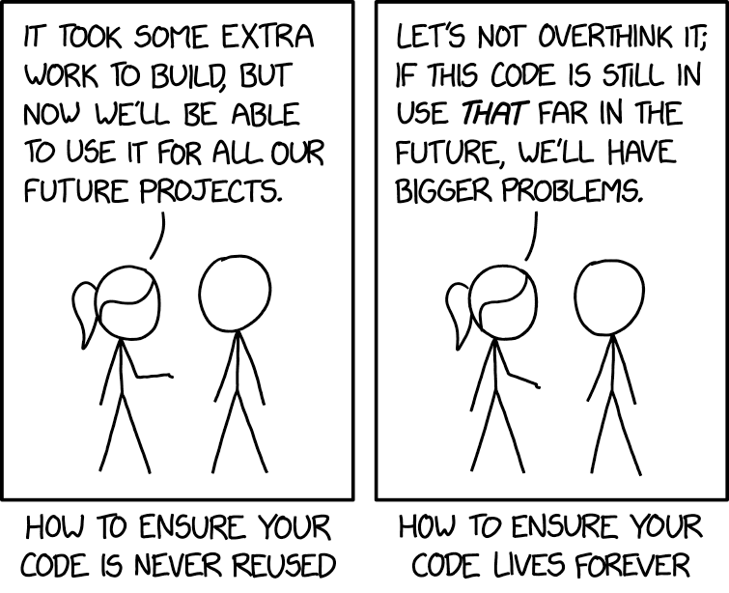
Overall Course Goal
Build software
With other people
Effectively
Over time

Slide 5
Course Philosophy
Learn the Theory (Version Control, Dependency Management, Design Patterns, etc)
Build a useful foundation
Practice with Specific Tools (Git, Gradle, Java, etc)
Current industry standard versions because why not

Slide 6
Development Ecosystem
Version Control + Local Checkout + Build System Management + IDE = Success
Specifics:
Github + Github Desktop + Gradle + Eclipse

Slide 7
Supported vs. Allowed
Common distinction in industry
Allowed vs Not Allowed: Security, Dogfooding
Supported vs Not Supported: Standard workflow, existing expertise

Slide 8
Are Those Exact Specifics Required?
Github = Required (others not allowed)
Github Desktop = recommended, but any Git client will work
Supported: Github Desktop, command-line git
Can use multiple clients at the same time, low risk to experiment here
Gradle = Required
Maven: technically allowed, but a lot more work, unsupported
Eclipse = strongly recommended
VSCode: not allowed, because it’s missing required features
IntelliJ: allowed, unsupported (FYI, they embrace ‘move fast and break things’)

Slide 9




Basic Workflow
Changes to the files
VCS (Github)
Your local copy on your laptop

Slide 10
Basic Workflow
Git Client
(Github Desktop)
syncs to cloud

Slide 11

Basic Workflow
All repository files are stored in the File System

Slide 12

Basic Workflow
Dependency Management (Gradle)
reads the files and creates
local metadata files
This includes IDE-specific configuration (either Eclipse or IntelliJ)

Slide 13

Basic Workflow
Your IDE (Eclipse) can be configured locally without affecting anyone else

Slide 14
Demo! (Time Permitting)
Grab the starter code
Import into IDE
Commit changes
Invite users to a repo

Slide 15

Code Reviews: Cheap Way to Avoid Bugs
Software equivalent of editing a paper
Rough estimate:
A bug that takes 1 minute to fix if flagged in a code review will take:
10 minutes to fix if flagged in a manual testing pass
100 minutes to fix if shipped to production

Slide 16
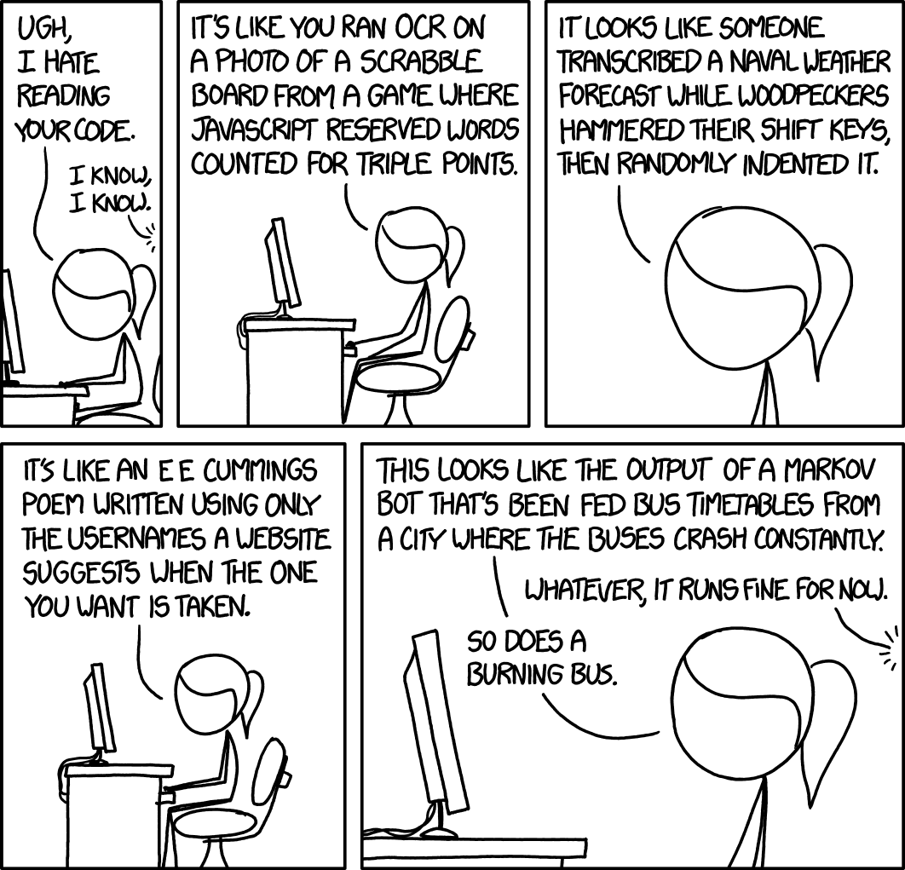
Code Reviews: Cheap Way to Avoid Bugs
…But Only If Done Right
Best practices make Code Reviews
Lightweight
Effective at spotting issues
Pleasant

Slide 17
Structuring Code For Code Review
Style conventions are aspects of code not enforced by the compiler, but which make code much more approachable:
Ex:
int getWidth() {
return width;
}
and
rectangle.getWidth()
vs
int Width(){return a;}
and
b.Width()

Slide 18


Structuring Code For Code Review
But wait, those two bits of code looked equally easy to read!
Conventions develop value over time
Compare two icons:
vs
The first time you encounter a 'Save' icon, either of those makes as much/little sense as the other.
Once you've seen 50, the one on the left is much easier to recognize

Slide 19
Structuring Code For Code Review
Some typical conventions (not exhaustive):
methods and variables begin with a lowercase letter (int width, void doThing())
constants are all caps (int x = DEFAULT_VAL;)
class names begin with a capital letter (public class Math {})
Some optional conventions: pick something and be consistent in the code base
tabs vs 2 spaces vs 4 spaces
{ on a newline vs with a space

Slide 20
Structuring Code For Code Review
Beyond surface-level conventions, make sure to:
Include comments on why some code exists, not what it does:
// adds 2 to x
x += 2;
vs
// We're only considering even numbers
x += 2;

Slide 21
Structuring Code For Code Review
Remember good object oriented practices
A class should have one data concept, a method should have one task/behavior; if you can't describe it with a single sentence, or if you're using the word "and", be suspicious (this is a code smell)
Ex: getWidthAndHeight() vs getWidth(), getHeight();

Slide 22

Structuring Code For Code Review
Not a hard-and-fast rule:
// Represents a deck of cards. Supports shuffling and dealing.
public class Deck {
List<Card> cards;
public void shuffle() {}
public void deal() {}
}
There are multiple sentences and an 'and', but there's a single 'data' concept and the two 'behaviors' are both closely related to the data and in separate methods

Slide 23

Structuring Code For Code Review
// Represents card numbers and suits
public class Deck {
List<Integer> cardNumbers;
List<Integer> cardSuits;
}
The 'and' here is in fact a problem - we're not properly encapsulating the data. The two items being 'and'ed together are closely related, which for data means they should be grouped in their own class (Card)
/* Represents a deck of cards. Supports shuffling and coordinates placing pieces on a game board */
public class Deck {
List<Card> cards;
public void shuffle() {}
public void initializeBoard() {}
}
Here, the 'and' is a problem because the two behaviors are very different; a game board has nothing to do with a deck of cards.

Slide 24
Structuring Code For Code Review
Code shouldn't be surprising:
Main.java:
System.out.println("Rectangle width: " +
rectangle.getWidth());
Rectangle.java:
public int getWidth() {
setHeight(3); // ← eek!
return width;
}

Slide 25
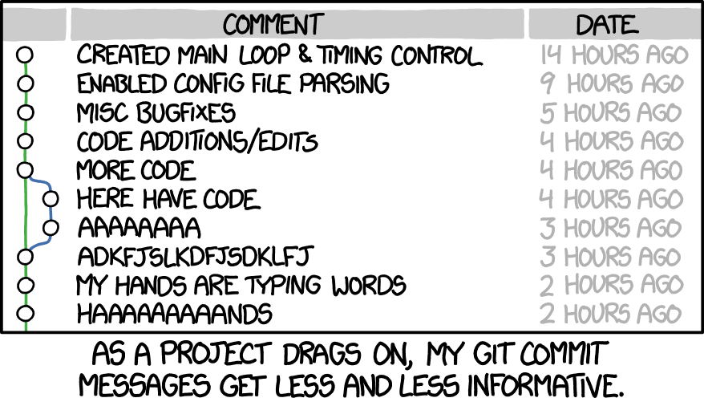
Structuring Commits For Code Review
Manageable size (less than 200 lines of non-auto-generated code)
Detailed description, descriptive summary message
Single feature/bug/task

Slide 26
Giving a Code Review
Step 1: Grok the code
Read the commit summary & description
Skim through the whole change
Do a second pass for deeper understanding
Make notes of anything that looks unclear
If necessary, sketch out a diagram/outline of what the change is doing

Slide 27
Giving a Code Review
Step 2: Comment on larger issues
Be nice! Criticism always feels harsher on the receiving end than the giving end
A code review is a conversation - for larger changes, expect to have multiple rounds of commits/reviews
Topics:
Bugs: if something looks functionally broken
Lack of testing: make sure there are at least basic tests
Unclear code: missing comments, code that isn't self-documenting
Structural issues (layers of abstraction/API design)

Slide 28
Giving a Code Review
Step 3: Proofreading for stylistic issues
For small issues: by convention, start with "nit:": Ex: "nit: add a newline between imports and class declaration"
Whitespace/formatting
typos in variable names
suboptimal return statements:
Ex: "nit: return hasProperty; vs return hasProperty == true;"
These shouldn't block approvals, but should be fixed up before merging
Avoid micromanaging
Determine if another way is genuinely better, or just different

Slide 29
Demo!
Leave inline comments
Resolve comments

Slide 30

Using a Linter
Code reviews that spend a lot of time on nits are sub-optimal
Fortunately, some formatting issues are easy to spot programmatically
A linter is something that cleans up code "lint" - the small bits of easily removed fluff to leave clean and polished code behind
checkstyle is an open source, easily configured version, which we'll be using.

Slide 31
Using Checkstyle With Github
We're going to hook up a custom checkstyle config to the status checks in Github
Every Pull Request will automatically trigger these checks
Don't request a review/don't leave a review until these checks pass
They should be very quick
This is an example of Continuous Integration (CI)
Note: there are lots of ways to call checkstyle, including from gradle and as an Eclipse plugin. Feel free to add additional calls/checks for your project!

Slide 32
Continuous Integration
Shorten the loop between code being written and being deployed to production
Automates error detection, shipping, and rollbacks
Complexity ranges from very simple (checkstyle checks) to very complex (automated canary rollouts with rollbacks if certain metrics spike)
Benefits:
Faster feedback
Easier to launch features
Higher quality code

Slide 33

Pair Programming
Combines the coding and code review steps
Requires 2 people looking at the same screen with low-friction instant communication (ideally in-person, but screenshare with discord also works; email does not count as low-friction instant communication, though)
One person types, the other reviews
Good for the first several commits of a large, complex architecture
avoids latency and context switching from code reviews
When committing, note in the commit description that the code was pair-programmed (and with who); this should line up with the person who then approves the pull request

Slide 34
Where/How to Write Code
Ex: Writing a 20 page research paper
You could use a plain text editor, but you probably wouldn't
Instead, google docs/libre office/ms word:
Spell check
Grammar check
Formatting
Text suggestions
These tools are integrated into your word processing environment

Slide 35
Where/How to Write Code
Same for code! Use an Integrated Development Environment (IDE)
Constant compilation/compile error readout
Warnings
Syntax highlighting
Auto-formatting
Auto-completion/auto-generated code

Slide 36


IDE for Java
Recommended: Eclipse
Fully featured
Easy to migrate from this to other tools
Optional: IntelliJ
Industry standard
Not so great if you don't have a build tools team
Do Not Use: Visual Studio Code (VSCode)
Buggy
Slow
Poor Gradle integration

Slide 37
Unlock the Power of the IDE
Emacs/notepad is fine for C code, but modern languages are designed to be written with an IDE
Solves the complexity to type vs complexity to read tradeoff
Minimizes "toil"
Allows for easy navigation of object-oriented code
Shortcuts in the IDE are HUGE for productivity, they are absolutely worth learning

Slide 38
Deterministic vs Stochastic Code Generation
Deterministic: Compiler, Many IDE tools
No need to double-check output (“Just glance through the .class bytecode to make sure it’s right” said no one ever)
Solves specific problems
Non-deterministic (stochastic): LLMs, other ML models, stack overflow
Must double-check output
Can attempt any problem, but no guarantee of successfully solving
⇒ For any problem that can be solved deterministically, prefer that option
This requires knowing when those options exist

Slide 39
Organize Imports
Eclipse shortcut: ctrl + shift + o
Doesn't just "organize" existing imports
Searches the classpath for any unreferenced types, and attempts to add them
Classic API design:
Import package structure is an implementation detail
The library classes/interfaces are the API
Organize imports = "Hey IDE, I want this class. Go find it for me"

Slide 40
Auto-Refactor
Eclipse shortcut:
Rename: alt + shift + r
Extract method: alt + shift + m
Rename Classes/parameters/methods/interfaces
Extract methods
⇒ Reduces the cost of readability/maintainability fixes

Slide 41
Autocomplete
Eclipse shortcut: ctrl + space
Long variables/methods
⇒ Prioritize readability without a hit to productivity
Forgot a method? The IDE is here to help!
Eclipse shortcut: type . and wait
⇒ Efficiently use a large number of libraries

Slide 42
Navigate Object Hierarchy
Eclipse shortcut: ctrl + click
Object Oriented Programming has tons of classes, interfaces, and instance variables that all interact across files
Navigating in the file structure is sloooooow
⇒ context switching is expensive
⇒ reasoning about the whole system is difficult
Better: click-through navigation in the IDE

Slide 43
And Many More!
Deterministic generation (no generative AI, please!):
hashcode/equals/toString
getters/setters
try/catch blocks
unimplemented methods
Auto-format files
"On save" actions
Etc.

Slide 44
Let's Review!
What you should know from this week that might be on an exam:
Version Control: What is it, what are branches, when would you use a feature vs. release branch
Github Workflow: What is a Pull Request, what is branch protection, what are status checks
Code Reviews: Why have them, the 3 features of a good code review process, tips for structuring code and commits for review, and the 3 steps in giving a code review
Style Conventions: What are some common ones, why are they important
Continuous Integration: What are some examples, what are some benefits
Pair Programming: What is it, and what problem with standard code reviews does it solve
Build Tools: Common tools, why they're useful
IDEs: Common IDEs, why they're useful

